Slide 1

Java : A developer’s view

Slide 2
About me
Github → https://github.com/gentjankolicaj
Linkedin →https://al.linkedin.com/in/gentjan-koli%C3%A7aj-559301160

Slide 3
About presentation
Topics :
Java language & JVM
Some famous tech/libs for desktop/web/testing/automation
Facts vs opinions
Recommended audience :
Students,junior developers,lazy people...

Slide 4
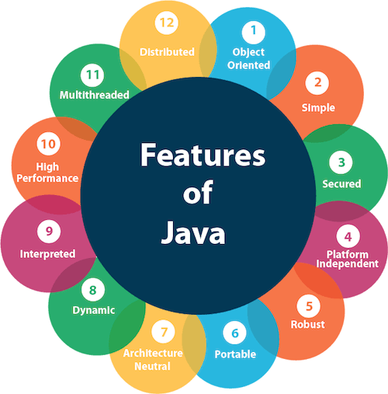
Java features

Slide 5
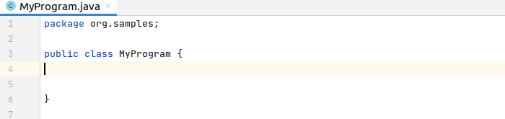
How it all starts...
Class

Slide 6
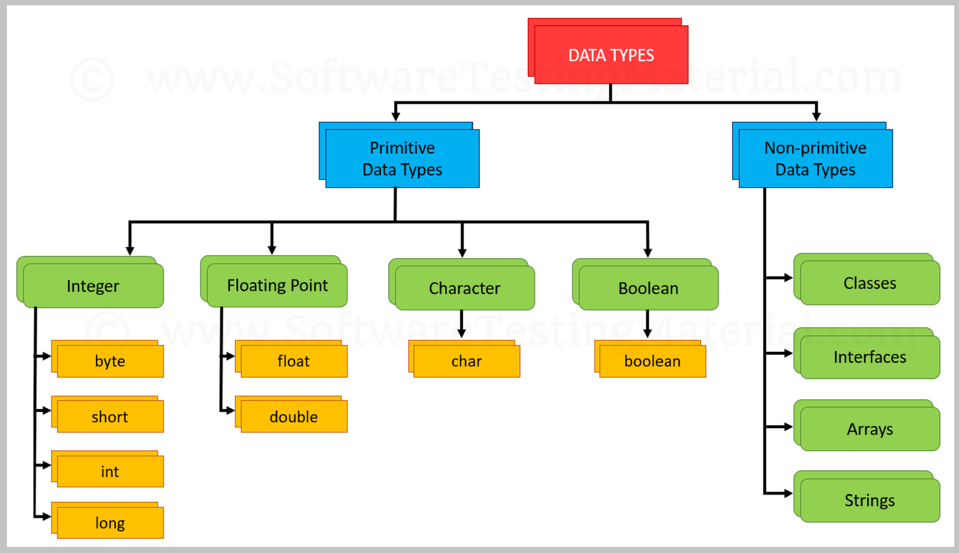
Data types

Slide 7
Object-oriented programming
Object which has state and behavior...
Inheritance ( extends )
Polymorphism ( implements )
Abstraction
Encapsulation (public,protected,private)

Slide 8

That moment when...
Show me some code...

Slide 9
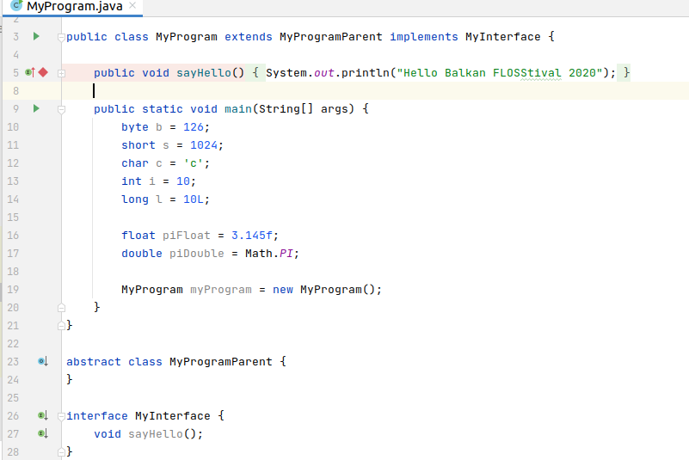
THE CODE...

Slide 10


Slide 11
Java virtual machine (JVM)
JVM is a virtual machine that enables a computer to run Java programs as well as programs written in other languages that are also compiled to Java bytecode.
The JVM is detailed by a specification that formally describes what is required in a JVM implementation.
Having a specification ensures interoperability of Java programs across different implementations

Slide 12
JVMs
Azul Zulu — is an OpenJDK build supported by Azul Systems and is compliant with the Java SE 11, 8, 7, and 6 standards.
Codename One — uses the open source ParparVM
Eclipse OpenJ9 — open-source from IBM J9, for Windows, AIX, Linux (x86, Power, and Z), macOS, MVS, OS/400, Pocket PC, z/OS.
GraalVM — is based on HotSpot/OpenJDK, it has a polyglot feature, to transparently mix and match supported languages.
HotSpot — the open-source Java VM implementation by Oracle.
JamVM — developed to be an extremely small virtual machine compared to others. Designed to use GNU Classpath. Supports several architectures. GPL.
Jikes RVM (Jikes Research Virtual Machine) — research project. PPC and IA-32. Supports Apache Harmony and GNU Classpath libraries. Eclipse Public License.

Slide 13
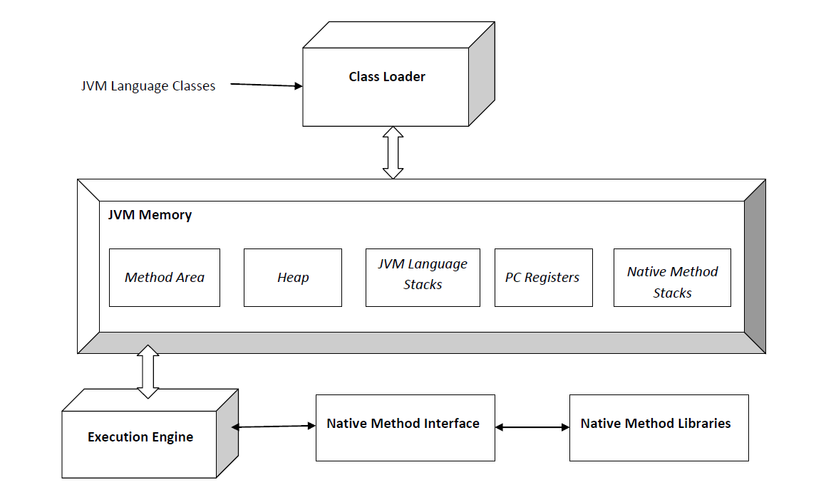
JVM architecture

Slide 14
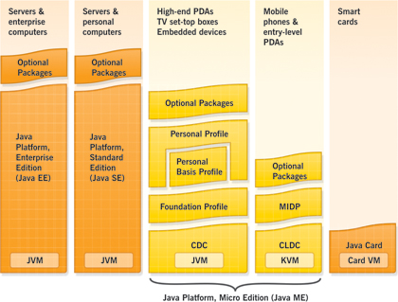
Java presence...

Slide 15
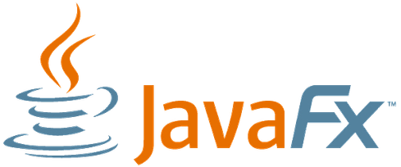
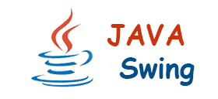
Desktop techs/libs
Swing → https://docs.oracle.com/javase/tutorial/uiswing/start/index.html
Java Fx → https://wiki.openjdk.java.net/display/OpenJFX/Main

Slide 16




Some web tech/libs
Spring → https://spring.io/
Quarkus → https://quarkus.io/
Play Framework → https://www.playframework.com/
Micronaut → https://micronaut.io/

Slide 17




Some testing tech/libs
JUnit 4 & JUnit 5 → https://junit.org/junit5/
TestNG → https://testng.org/doc/index.html
Mockito → https://site.mockito.org/

Slide 18


Some automation tech/libs
Appium → https://appium.io/
Selenium → https://www.selenium.dev/

Slide 19
Tools
IDE : IntelliJ-IDEA, Eclipse, Netbeans...
JvisualVM, Jshell, FlightControll...
Maven, Ant, Gradle,
Jenkins

Slide 20
1.Opinions vs facts
Hard to learn | Syntax is similar to C & C++
Boilerplate code | Project lombok & JAVA 10 var
Interpreted | Yes and that is one of reasons we have WORA
Large memory footprint | Lot a grey area there,but this is the price you pay when you have a JVM
Stop world events | 1.Manage object destruction yourself ( Trader’s way ) 2.Invent a way to destroy objects without stop-world events (Hero’s way)
Security issues | Without JVM would be a worse
Not much of fan of camel case | Well you can have your own conventions as long as nowbody is going to work with your code

Slide 21
2.Opinions vs facts
Hidden relationship between code and hardware | To some extent I agree.
Not so good for ML & Big data. | True but project Valhalla is addressing this issue.
Threads are kind off heavy objects | Yes and no,but if you want to get another alternative check project Loom.
Large array issue ( not supporting arrays of more than 2^31−1 (about 2.1 billion) elements | Yes ,language limitation/issue and is more than that.

Slide 22
References
https://docs.oracle.com/javase/tutorial/getStarted/intro/definition.html
https://en.wikipedia.org/wiki/Java_%28programming_language%29
https://www.javatpoint.com/features-of-java
https://netbeans.org/community/magazine/html/03/mobpack/
https://en.wikipedia.org/wiki/Criticism_of_Java
https://techvidvan.com/tutorials/features-of-java-programming-language/
https://www.softwaretestingmaterial.com/data-types-in-java/

